Slide 1


Green Pace
Security Policy Presentation
Developer: Anthony Vigil
Anthony Vigil
06/12/23
Project Two: Security Policy Presentation
Video Link: https://youtu.be/wjOHw1qKltU

Slide 2

OVERVIEW: DEFENSE IN DEPTH
This model is to give an overview of the detailed methods of defense that are utilized to maintain secure coding.
Defense in depth refers to the approach in information security where the security mechanisms are layered to create a stronger protection against all risks within the system.

Slide 3
THREATS MATRIX
Secure coding standards come with certain levels of vulnerability to measure the impact of that certain standard.
The example shown is a chart that prioritizes those levels.
PROBABILITY | SEVERITY | Severity
 | LOW HARM | MEDIUM HARM | HIGH HARM
LIKELY |  |  | STD-004-CPP STD-005-CPP STD-009-CPP STD-010-CPP
PROBABLE | STD-007-CPP |  | STD-002-CPP STD-008-CPP
UNLIKELY | STD-006-CPP | STD-001-CPP | STD-003-CPP

Slide 4
10 PRINCIPLES
1. Validate Input Data
STD-001-CPP
STD-002-CPP
STD-004-CPP
STD-008-CPP
STD-009-CPP
STD-010-CPP
2. Heed Compiler Warnings
STD-007-CPP
3. Architect and Design for Security Policies
4. Keep It Simple
STD-002-CPP
STD-003-CPP
STD-004-CPP
STD-005-CPP
STD-010-CPP
5. Default Deny
STD-006-CPP
6. Adhere to the Principle of Least Privilege
7. Sanitize Data Sent to Other Systems
STD-004-CPP
8. Practice Defense in Depth
9. Use Effective Quality Assurance Techniques
STD-003-CPP
10. Adopt a Secure Coding Standard
STD-006-CPP
“Top 10 Secure Coding Practices.” Top 10 Secure Coding Practices - CERT Secure Coding - Confluence, wiki.sei.cmu.edu/confluence/display/seccode/Top+10+Secure+Coding+Practices?focusedCommentId=88044413. Accessed 12 June 2023.

Slide 5
CODING STANDARDS
Do not cast to an out-of-range enumeration value
Use valid references, pointers, and iterations to reference elements of a container
Do not attempt to create a std::string from a null pointer
Do not store already-owned pointer value in an unrelated smart pointer
Properly deallocate dynamically allocated resources
Use a static assertion to test the value of a constant expression
Handle all exceptions thrown before the main() begins executing
Do not alternatively input and output from a file stream without an intervening positioning call
Do not invoke virtual functions from constructors or destructors
10. Value returning functions must return a value from all exit paths

Slide 6
CODING STANDARDS CONTINUED..
Rule | Severity | Likelihood | Remediation Cost | Priority | Level
STD-010-CPP | High | Likely | Medium | High (18) | 1
STD-009-CPP | High | Likely | Medium | High (18) | 1
STD-005-CPP | High | Likely | Medium | High (18) | 1
STD-004-CPP | High | Likely | Medium | High (18) | 1
STD-008-CPP | High | Probable | High | Medium (6) | 2
STD-002-CPP | High | Probable | High | Medium (6) | 2
STD-007-CPP | Low | Probable | Medium | Low (4) | 3
STD-003-CPP | High | Unlikely | High | Medium (6) | 2
STD-001-CPP | Medium | Unlikely | Medium | Low (4) | 3
STD-006-CLG | Low | Unlikely | High | Low (1) | 3

Slide 7
ENCRYPTION POLICIES
Encryption In Rest - Designed to prevent the attacker from accessing the unencrypted data by ensuring the data is encrypted on the disk. If attackers obtain hard drive with the encrypted data, it will be protected due to the attackers not having the encryption key.
Includes: Phones, Cloud Assets, Computer, Hard Drives, etc.
Encryption At Flight – Process of encrypting data while the data is being transmitted. On applications, the data is unencrypted at rest but encrypted during transmission.
Includes: Devices that are in a network or are actively moving being transferred outside of the network.
Encryption In Use – Compromising data in use enables access to encrypted data that is at rest and data in motion. Users with access to RAM, random access memory, can parse that memory to locate the encryption key for data at rest which would allow them to decrypt the encrypted data if the encryption key is obtained.
Securing and checking protection is done before is it used.

Slide 8
TRIPLE-A POLICIES
Authentication – Authentication refers to the user being confirmed as someone who has access to the system. This includes user login and password information.
Authorization – Authorization refers to the level of access that a user has within the system. This includes if the user can create, read, delete or modify files within the database.
Accounting – Accounting refers to the process of keeping track of the activity of a user while they are interacting with the system. It shows accessed resources, timestamps, or any information that was transferred.
Mylonas, Leo. “What Is AAA Security? An Introduction to Authentication, Authorisation and Accounting.” Codebots, 27 Nov. 2018, codebots.com/application-security/aaa-security-an-introduction-to-authentication-authorisation-accounting.

Slide 9
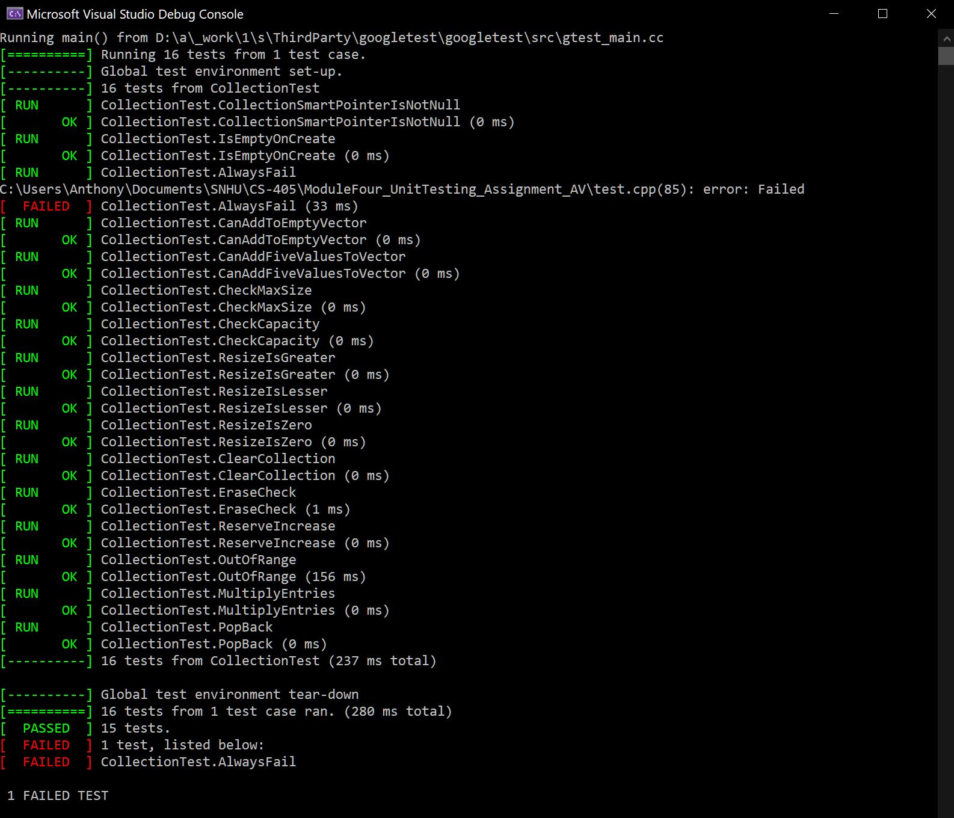
Unit Testing
The unit testing practices come early and should be done often to ensure the code is secure and functional. Unit testing is done all throughout the development process.
The example on the image shows the tests done, such as CheckMax that checks the number of characters within the user input string to prevent buffer overflow.
Cppcheck, cppcheck.sourceforge.io/. Accessed 12 June 2023.

Slide 10

AUTOMATION SUMMARY

Slide 11
TOOLS
The DevSecOps pipeline is a secure coding method that has a full circle approach to enforcing a policy that has an infrastructure built on efficiency keeping the code secure.
This is a solid structure for the system as it would keep the defense in depth in mind while also making sure the testing is done early. This helps detect and prevent vulnerabilities and flaws.

Slide 12
RISKS AND BENEFITS
The risks include not confirming if it is 100% secure. You should always assume the system or code is vulnerable or has warnings as it can help prevent future breaches and hacking. It is important to stay up to date on the code and use all sources available to help prevent hacking.

Slide 13
RECOMMENDATIONS
Keep up to date with all the security threats and trends
Maintain high level of security by always testing the code
Implement coding best practices
Keep everything simple and effective

Slide 14
CONCLUSIONS
In conclusion, by acknowledging the principles and practicing the standards mentioned in this presentation, our plan to create and maintain a secure code is efficient. Implementing a zero-trust policy when accessing both information inside and out of the network will keep safety at a high level. Ensuring all the sensitive information is secure is beneficial for all parties.

Slide 15
REFERENCES
Cppcheck, cppcheck.sourceforge.io/. Accessed 12 June 2023.
Mylonas, Leo. “What Is AAA Security? An Introduction to Authentication, Authorisation and Accounting.” Codebots, 27 Nov. 2018, codebots.com/application-security/aaa-security-an-introduction-to-authentication-authorisation-accounting.
“Top 10 Secure Coding Practices.” Top 10 Secure Coding Practices - CERT Secure Coding - Confluence, wiki.sei.cmu.edu/confluence/display/seccode/Top+10+Secure+Coding+Practices?focusedCommentId=88044413. Accessed 12 June 2023.

